Slide 1

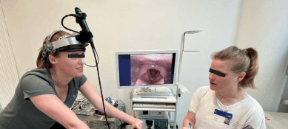
Automatic selection of suitable images from laryngoscopy videos
Final Project part A – 24-1-R-18
YOVEL COHEN
EYAL KOUBI
Supervisor: Dr. Elena Kleiman
27.5.2024

Slide 2
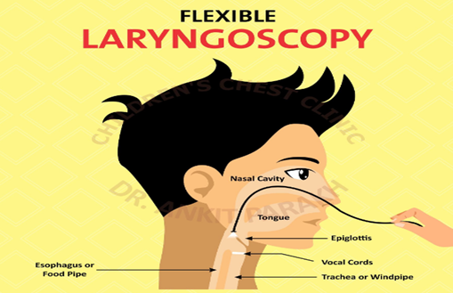
Problem Definition:
Current Diagnosis Challenges for LPR
LPR diagnosis: Poorly defined, misunderstood
Symptoms are varied and nonspecific.
Endoscopy relies on subjective assessments.
Patients' movements complicate image clarity.

Slide 3
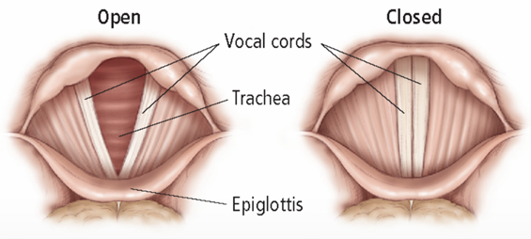
Problem Definition:
Necessity for an Advanced Diagnostic Tool
Existing methods insufficient for reliable diagnosis.
Need for objective, precise diagnostic tools.
Automated image analysis can enhance accuracy.
Stabilizes and selects optimal frames automatically.
Supports definitive diagnosis with clearer evidence.

Slide 4
Our Solution
Automated Frame Selection
Software selects high-quality frames from videos.
Uses advanced image processing techniques.
Enhances objectivity and precision in diagnosis.
Interface easy for medical professionals.

Slide 5
Our Solution
Algorithm Overview - Part 1
Start:
Input: Endoscopy test video.
Preprocessing:
Divide video into frames.
Convert frames from RGB to grayscale.
Frame Analysis:
For each frame:
Generate a histogram.
Apply the Otsu method to determine the optimal threshold.
Conduct region segmentation using the threshold.
Check for "V" shape in each region.

Slide 6
Our Solution
Algorithm Overview - Part 2
Frame Selection:
If "V" shape exists:
Add frame to the list.
Calculate motion vector between the current frame and the next frame.
Motion Consistency Check:
If motion vector is consistent:
Add next frame to the list.
Else:
Continue with next frame.
Final Selection:
Apply focus function to each frame in the list.
Cut and focus on sides and base of the triangle.
Select the top three qualitative frames based on base, sides, and overall aspect.
Output:
Return the final list of frames.
Notes:
Histogram Calculation: For each frame, a histogram is first calculated to understand the distribution of pixel intensities.
Otsu's Method: This statistical method is applied to determine the best threshold for segmenting the image into regions of interest.
Region Segmentation: Using the threshold from Otsu's method, the frame is segmented into regions, which are then analyzed for the presence of a "V" shape — indicative of the laryngeal structure.
Motion Vector Calculation: For frames where a "V" shape is found, motion vectors are calculated to identify stable frames (where movement is minimal and consistent), crucial for accurate diagnostics.
Focus Functions: These functions are applied to assess the clarity and focus quality of the regions, particularly the sides and base of the "V" shape.
Selection of Top Frames: The algorithm concludes by selecting the three most qualitatively superior frames based on specified criteria, which are expected to offer the best diagnostic visuals.

Slide 7
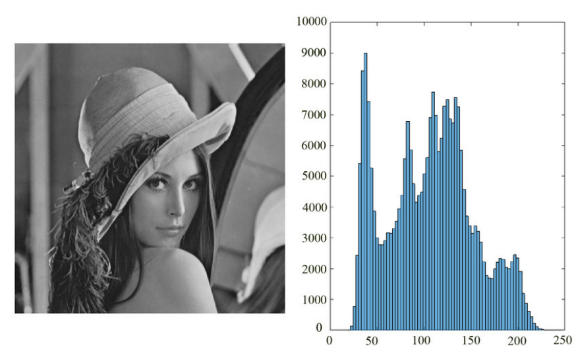
Algorithm steps
Histogram Creation and Otsu's Thresholding
Histogram Creation
Converts video frames to grayscale: Focuses on light intensity.
Creates histograms for each frame:
X-axis: Intensity values from 0 (black) to 255 (white).
Y-axis: Frequency of each intensity level.
Otsu's Thresholding
Finds optimal threshold to separate foreground from background.
Uses histogram data to maximize contrast between key image areas.
Notes:
Histogram Calculation: For each frame, a histogram is first calculated to understand the distribution of pixel intensities.
Otsu's Method: This statistical method is applied to determine the best threshold for segmenting the image into regions of interest.
Region Segmentation: Using the threshold from Otsu's method, the frame is segmented into regions, which are then analyzed for the presence of a "V" shape — indicative of the laryngeal structure.
Motion Vector Calculation: For frames where a "V" shape is found, motion vectors are calculated to identify stable frames (where movement is minimal and consistent), crucial for accurate diagnostics.
Focus Functions: These functions are applied to assess the clarity and focus quality of the regions, particularly the sides and base of the "V" shape.
Selection of Top Frames: The algorithm concludes by selecting the three most qualitatively superior frames based on specified criteria, which are expected to offer the best diagnostic visuals.

Slide 8
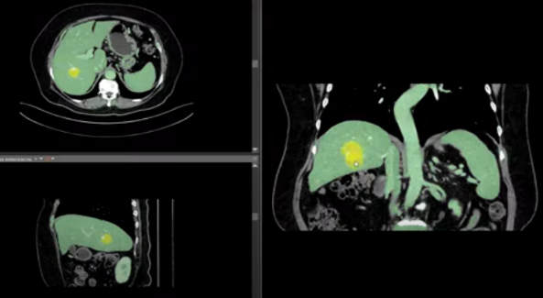
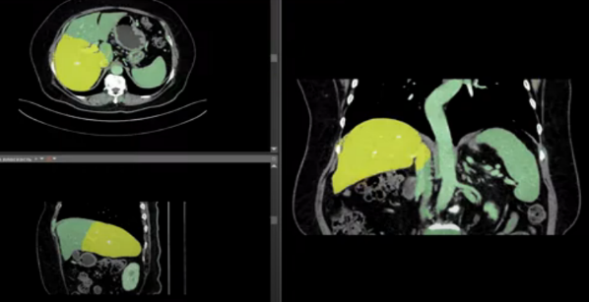
Algorithm steps
Region Segmentation Using Area Growing
Introduction
Objective: Precisely segment regions from medical images.
Challenges Addressed: Overcomes inconsistencies in lighting that affect traditional segmentation methods.
Methodology
Starting Point: Identifies the darkest pixel as the initial seed for region growth.
Expansion: Grows the region by incorporating adjacent pixels based on intensity and light variation tolerance.
Criteria for Growth:
Uses intensity thresholds from Otsu’s method.
Allows for light variation tolerance to handle minor intensity inconsistencies.
Notes:
Histogram Calculation: For each frame, a histogram is first calculated to understand the distribution of pixel intensities.
Otsu's Method: This statistical method is applied to determine the best threshold for segmenting the image into regions of interest.
Region Segmentation: Using the threshold from Otsu's method, the frame is segmented into regions, which are then analyzed for the presence of a "V" shape — indicative of the laryngeal structure.
Motion Vector Calculation: For frames where a "V" shape is found, motion vectors are calculated to identify stable frames (where movement is minimal and consistent), crucial for accurate diagnostics.
Focus Functions: These functions are applied to assess the clarity and focus quality of the regions, particularly the sides and base of the "V" shape.
Selection of Top Frames: The algorithm concludes by selecting the three most qualitatively superior frames based on specified criteria, which are expected to offer the best diagnostic visuals.

Slide 9
Algorithm steps
Triangle Detection
Introduction
Objective: Detect triangular shapes within images to identify the V-shaped structure of the larynx.
Importance: Enhances diagnostic accuracy for conditions like Laryngopharyngeal Reflux (LPR).
Methodology
Point Selection:
Lowest Point: Identify and use the lowest point for the triangle's base.
Most Up-Right and Up-Left Points: Select points that balance anatomical accuracy and clarity of the triangle’s shape.
Least Squares Fitting:
Hypothesis Formation: Model a triangle with chosen vertices.
Distance Calculations: Compute perpendicular distances from points to triangle sides.
Optimization Problem: Minimize the sum of squares of these distances to ensure the best fit.
Evaluation
Goodness of Fit: Use sum of squared residuals (RSS) to assess fit quality. Lower RSS indicates a better representation of the triangular structure.
Notes:
Histogram Calculation: For each frame, a histogram is first calculated to understand the distribution of pixel intensities.
Otsu's Method: This statistical method is applied to determine the best threshold for segmenting the image into regions of interest.
Region Segmentation: Using the threshold from Otsu's method, the frame is segmented into regions, which are then analyzed for the presence of a "V" shape — indicative of the laryngeal structure.
Motion Vector Calculation: For frames where a "V" shape is found, motion vectors are calculated to identify stable frames (where movement is minimal and consistent), crucial for accurate diagnostics.
Focus Functions: These functions are applied to assess the clarity and focus quality of the regions, particularly the sides and base of the "V" shape.
Selection of Top Frames: The algorithm concludes by selecting the three most qualitatively superior frames based on specified criteria, which are expected to offer the best diagnostic visuals.

Slide 10
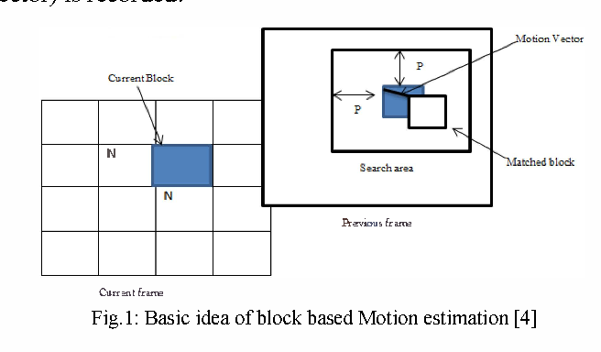
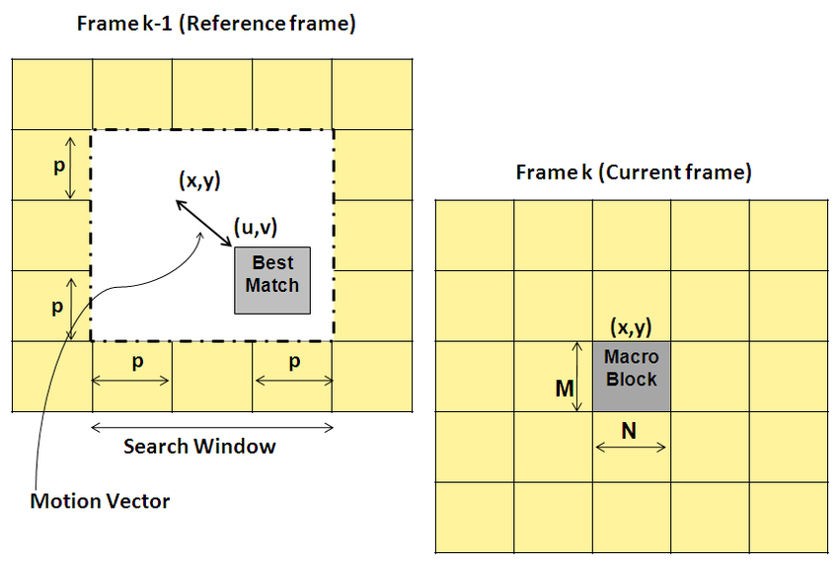
Algorithm steps
Block Matching for Frame Detection
Introduction
Purpose: Determine the suitability of subsequent frames in video sequences by tracking the V-shaped structure.
Focus: Analyze the triangle's boundary in frames to ensure consistent motion and reduce computational load.
Methodology
Boundary Definition: Concentrates on the boundary of the V shape to minimize analysis overhead.
Block Matching
Identify Matching Blocks: Searches for the best match along the V shape's boundary in the next frame.
Motion Vectors: Calculates displacement vectors to understand block movement.
Consistency Check: Evaluates motion consistency using motion vector distances, ensures reliability in tracking.
Notes:
Histogram Calculation: For each frame, a histogram is first calculated to understand the distribution of pixel intensities.
Otsu's Method: This statistical method is applied to determine the best threshold for segmenting the image into regions of interest.
Region Segmentation: Using the threshold from Otsu's method, the frame is segmented into regions, which are then analyzed for the presence of a "V" shape — indicative of the laryngeal structure.
Motion Vector Calculation: For frames where a "V" shape is found, motion vectors are calculated to identify stable frames (where movement is minimal and consistent), crucial for accurate diagnostics.
Focus Functions: These functions are applied to assess the clarity and focus quality of the regions, particularly the sides and base of the "V" shape.
Selection of Top Frames: The algorithm concludes by selecting the three most qualitatively superior frames based on specified criteria, which are expected to offer the best diagnostic visuals.

Slide 11
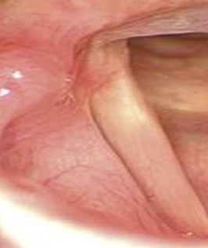
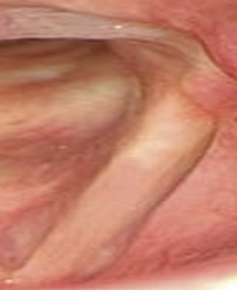
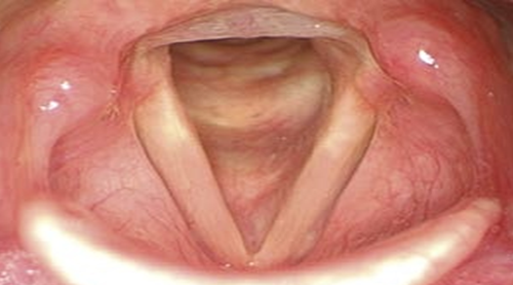
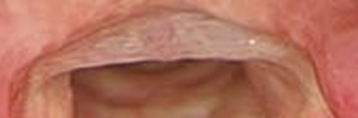
Algorithm steps
Frame Analysis for Optimal Focus Detection
Introduction
Purpose: Identify the sharpest frames to focus on crucial anatomical details in laryngoscopy videos.
Methodology
Segmentation Techniques: Isolate 'sides' and 'base' of the larynx for detailed focus evaluation.
Frame Segmentation
General Frame: Assesses overall frame focus.
Sides Segmentation: Analyzes lateral parts of the larynx, highlighting vocal folds.
Base Segmentation: Focuses on subglottic areas for precise evaluation.
Focus Measurement
Techniques Used: Squared Gradient, Brenner's Gradient, Variance of Intensities, and Vollath’s F4 Autocorrelation.
Application: Quantify sharpness and clarity of each segmented area.
Notes:
Histogram Calculation: For each frame, a histogram is first calculated to understand the distribution of pixel intensities.
Otsu's Method: This statistical method is applied to determine the best threshold for segmenting the image into regions of interest.
Region Segmentation: Using the threshold from Otsu's method, the frame is segmented into regions, which are then analyzed for the presence of a "V" shape — indicative of the laryngeal structure.
Motion Vector Calculation: For frames where a "V" shape is found, motion vectors are calculated to identify stable frames (where movement is minimal and consistent), crucial for accurate diagnostics.
Focus Functions: These functions are applied to assess the clarity and focus quality of the regions, particularly the sides and base of the "V" shape.
Selection of Top Frames: The algorithm concludes by selecting the three most qualitatively superior frames based on specified criteria, which are expected to offer the best diagnostic visuals.

Slide 12
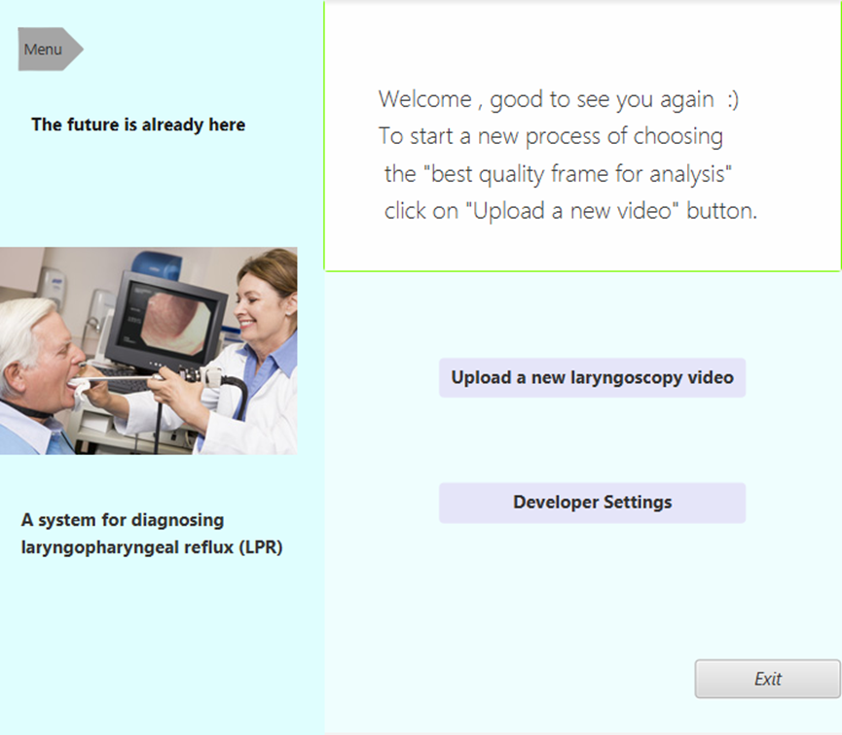
Product Diagram and GUI
Main Screen
Features two main interface elements.
"Upload new laryngoscopy video" button for all.
Allows video file uploads into the system.
"Developer Settings" button for developers.
Enables adjustment of system parameters.
Notes:
Histogram Calculation: For each frame, a histogram is first calculated to understand the distribution of pixel intensities.
Otsu's Method: This statistical method is applied to determine the best threshold for segmenting the image into regions of interest.
Region Segmentation: Using the threshold from Otsu's method, the frame is segmented into regions, which are then analyzed for the presence of a "V" shape — indicative of the laryngeal structure.
Motion Vector Calculation: For frames where a "V" shape is found, motion vectors are calculated to identify stable frames (where movement is minimal and consistent), crucial for accurate diagnostics.
Focus Functions: These functions are applied to assess the clarity and focus quality of the regions, particularly the sides and base of the "V" shape.
Selection of Top Frames: The algorithm concludes by selecting the three most qualitatively superior frames based on specified criteria, which are expected to offer the best diagnostic visuals.

Slide 13
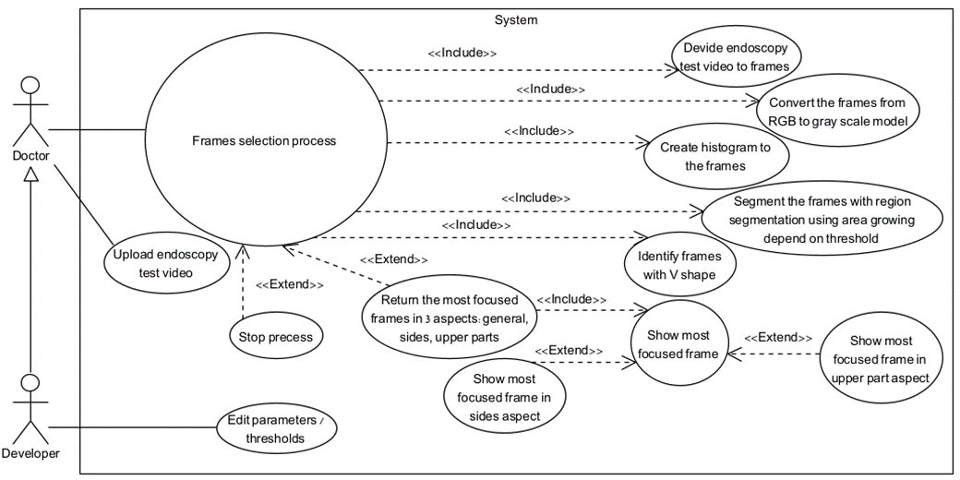
Product Diagram and GUI
Use Case Diagram
Notes:
Histogram Calculation: For each frame, a histogram is first calculated to understand the distribution of pixel intensities.
Otsu's Method: This statistical method is applied to determine the best threshold for segmenting the image into regions of interest.
Region Segmentation: Using the threshold from Otsu's method, the frame is segmented into regions, which are then analyzed for the presence of a "V" shape — indicative of the laryngeal structure.
Motion Vector Calculation: For frames where a "V" shape is found, motion vectors are calculated to identify stable frames (where movement is minimal and consistent), crucial for accurate diagnostics.
Focus Functions: These functions are applied to assess the clarity and focus quality of the regions, particularly the sides and base of the "V" shape.
Selection of Top Frames: The algorithm concludes by selecting the three most qualitatively superior frames based on specified criteria, which are expected to offer the best diagnostic visuals.

Slide 14
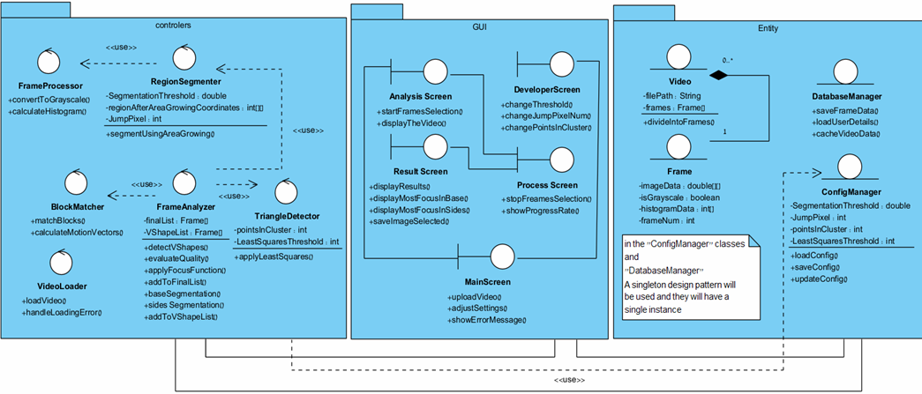
Product Diagram and GUI
Class Diagram
Notes:
Histogram Calculation: For each frame, a histogram is first calculated to understand the distribution of pixel intensities.
Otsu's Method: This statistical method is applied to determine the best threshold for segmenting the image into regions of interest.
Region Segmentation: Using the threshold from Otsu's method, the frame is segmented into regions, which are then analyzed for the presence of a "V" shape — indicative of the laryngeal structure.
Motion Vector Calculation: For frames where a "V" shape is found, motion vectors are calculated to identify stable frames (where movement is minimal and consistent), crucial for accurate diagnostics.
Focus Functions: These functions are applied to assess the clarity and focus quality of the regions, particularly the sides and base of the "V" shape.
Selection of Top Frames: The algorithm concludes by selecting the three most qualitatively superior frames based on specified criteria, which are expected to offer the best diagnostic visuals.

Slide 15
Evaluation / Verification Plan
Notes:
Histogram Calculation: For each frame, a histogram is first calculated to understand the distribution of pixel intensities.
Otsu's Method: This statistical method is applied to determine the best threshold for segmenting the image into regions of interest.
Region Segmentation: Using the threshold from Otsu's method, the frame is segmented into regions, which are then analyzed for the presence of a "V" shape — indicative of the laryngeal structure.
Motion Vector Calculation: For frames where a "V" shape is found, motion vectors are calculated to identify stable frames (where movement is minimal and consistent), crucial for accurate diagnostics.
Focus Functions: These functions are applied to assess the clarity and focus quality of the regions, particularly the sides and base of the "V" shape.
Selection of Top Frames: The algorithm concludes by selecting the three most qualitatively superior frames based on specified criteria, which are expected to offer the best diagnostic visuals.

Slide 16
Goals of Our Project
Develop optimal frame selection algorithm.
Enhance diagnostics with decision-support tools.
Tailor image processing to laryngoscopy needs.
Establish robust test plans for validation.
Improve patient care through precise diagnostics.

Slide 17
Expected Challenges
Overcome data scarcity for training models.
Ensure algorithm stability across variable video quality.
Adapt image processing to detect V-shape consistently.
Manage computational demands in real-time analysis.
Integrate seamlessly with existing medical systems.

Slide 18
Thank you for listening

